Slide 1

TATA Vs Mistry Case Study
Submitted By-
Shankh Bansal
AU22C1013
Submitted To-
Dr. Nitin Sharma

Slide 2

Index
Company Profile
Cyrus Mistry
Controversy
Reason for the controversy
Impact
How was it Rectified
Recommendations

Slide 3
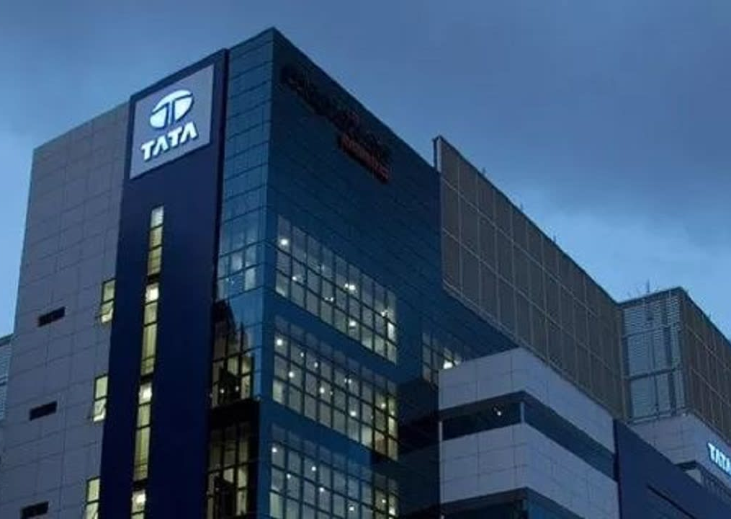
Company Profile
Founded by Jamsetji tata in 1868, the tata group is a global enterprise.
Mission 'To improve the quality of life of the communities we serve globally, through long term stakeholders value creation based on leadership with Trust'.
Tata Sons- Principal investment holding company and promoter of tata companies.
There are 29 publicly-listed tata enterprises.
Each tata enterprise operates independently under the supervision of its own board of directors and shareholders.

Slide 4
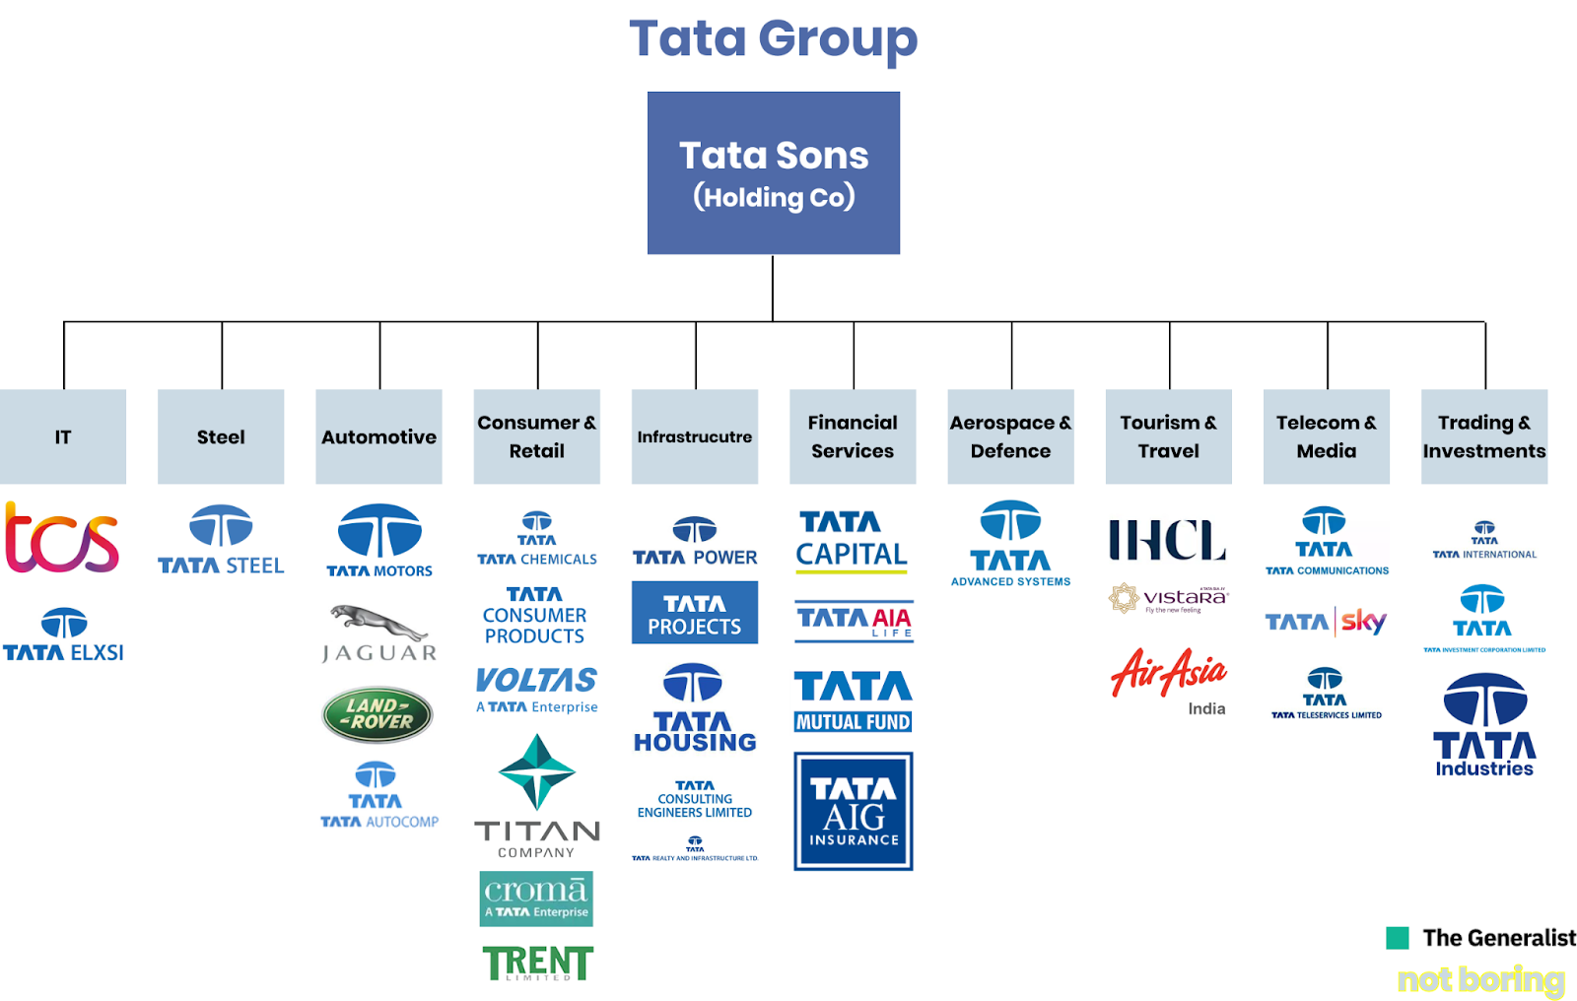
Tata Products

Slide 5
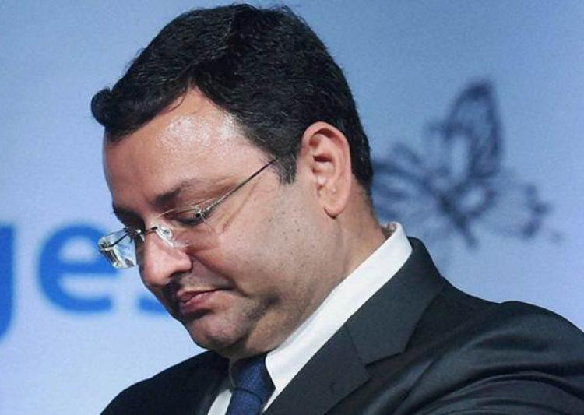
Cyrus Mistry
Mistry graduated with a degree in civil engineering from imperial collage London ,UK ,in 1990.
In 1997, he received an MSc in management from the London Business school.
Mistry serve as the co-chair of the India-US CEO forum and the India-UK CEO Forum.
Mistry was earlier managing directors of the Shapoorji Pallonji Group.

Slide 6
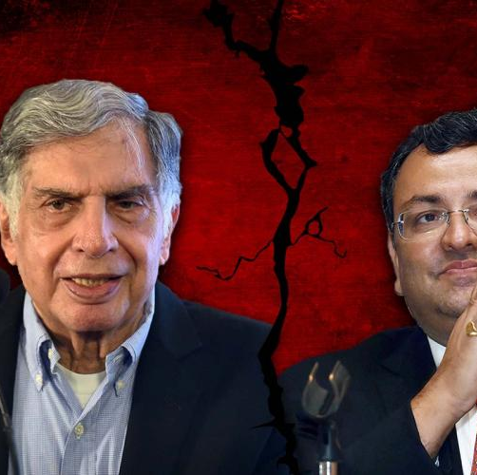
Controversy
Tata – Mistry Saga
Oct 24,2016 – Cyrus Mistry fired as tata sons chairman.
Oct 25,2016 – Mistry attacks tata sons board, alleges inappropriate control of Tata trust & Ratan Tata on Tata sons.
Dec 19,2016 -Mistry Resign from board of Tata Sons.
Dec 20,2016 -Mistry firms move NCLT alleging oppression of minority rights at Tata Sons.
Feb6, 2017 - Tata sons remove Mistry as director from board.
Mar6, 2017 - NCLT says Mistry petition not maintainable, cites insufficient shareholding.
July9, 2017 - NCLT dismisses Mistry petition, says it finds no merit in accusation.
Sep21, 2017 - NCLAT allows Mistry to file case against Tata Sons.
Tata – Mistry Sag
Source – Economic Times, Date Jul 10,2018.

Slide 7
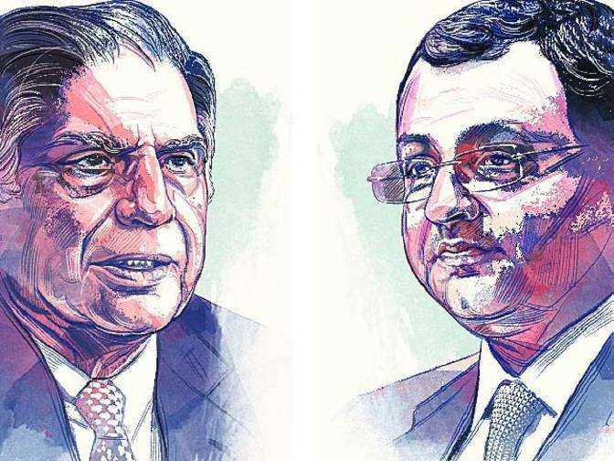
The Boardroom Battle
Cyrus Vs Tata on "lame duck" Chairman.
Tata questions Mistry performance.
Mistry shock on his ouster.
Mistry vs Tata on accusation of personal rivalry.

Slide 8
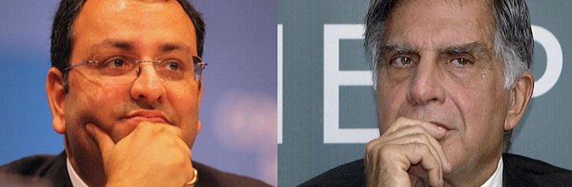
Reason for the controversy
Conflict of Interest – Orissa elections.
Failed to dissociate himself from the Self held family business.
Mistry decisions to acquire assets without seeking an approval from the board & investors.
Nudging the Tata company CEOs to change focus.

Slide 9

Impact
Reputation was the biggest casualty in Tata group tussle.
On October 26,2016 ;Stocks of listed Tata companies fell by 3.16%.
Raised questions about corporate governance practices in India.

Slide 10
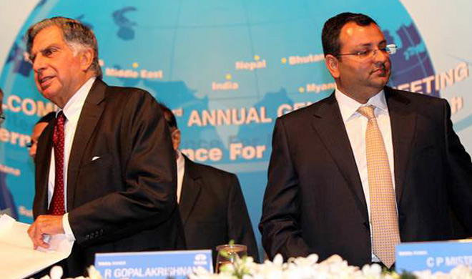
How was it Rectified?
Tata sons filed a caveat in supreme court, High court and the (NCLT) so that no ex-parte order can be passed.
Jan 12,2017: Tata sons name N Chandrashekaran as chairman.
Feb 6,2017: Mistry removed from the post of director of tata sons board.
Sep 21,2017: Tata sons' Board approves plan to become a private company.

Slide 11
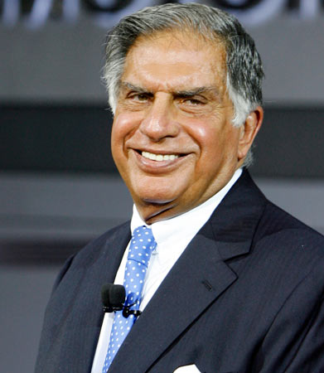
Recommendations
Succession: planning needs to be planned for well in advance.
Ensure board: members have the rights blend of values since they can influence quality of governance.
The importance of fostering: An environment of mutual trust and confidence among stakeholders.
Need for Leaders: Who can handle change and grow the company through and disparate set of internal & external stakeholders.

Slide 12

Thank you
Shankh Bansal
shankh.bansal@avantika.edu.in

